Slide 1
Backpropagation in Practice

Slide 2
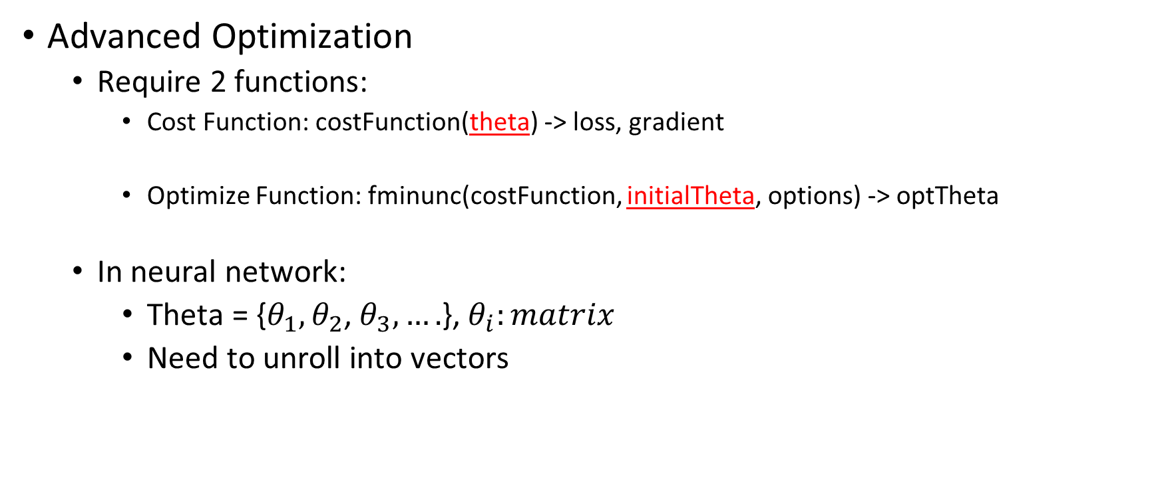
Unrolling Parameters
Advanced Optimization
Require 2 functions:
Cost Function: costFunction(theta) -> loss, gradient
Optimize Function: fminunc(costFunction, initialTheta, options) -> optTheta
In neural network:
Theta = {$θ_{1},θ_{2}$, $θ_{3},….$}, $θ_{i}:matrix$
Need to unroll into vectors
Vector

Slide 3
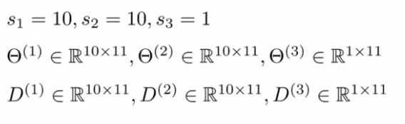
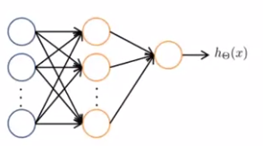
Unrolling Parameters
Example
Python
theta = np.concatenate((theta1.ravel(), theta2.ravel(), theta3.ravel()))
D = np.concatenate((d1.ravel(), d2.ravel(), d3.ravel()))
theta1 = theta[0:110].reshape(10, 11)
theta2 = theta[110:220].reshape(10, 11)
theta3 = theta[220:231].reshape(1, 11)

Slide 4
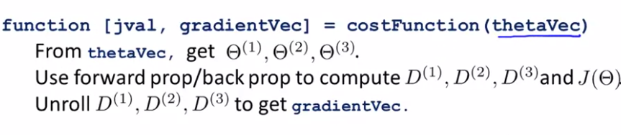

Unrolling Parameters
Have initial parameters $θ_{1},θ_{2},θ_{3}$
Unroll into vectors to pass to optimize function fminunc

Slide 5
Gradient Checking

Slide 6
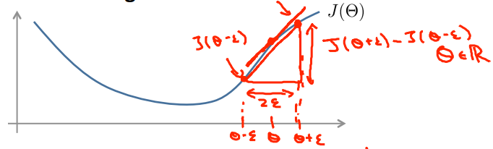
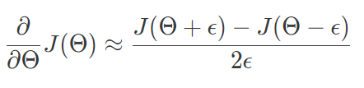
Gradient checking
Gradient checking will assure that our backpropagation works as intended.

Slide 7
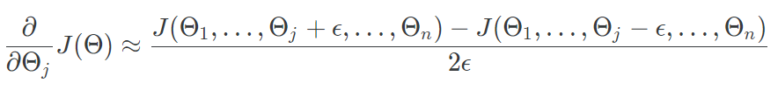
Gradient checking
With multiple theta matrices:
Usually uses the value epsilon = 10⁻⁴

Slide 8
Gradient Checking
Implementation Note:
Implement backpropagation.
Implement numerical gradient checking.
Make sure they give similar values.
Turn off gradient checking (The code to compute is very slow). Using backprop code for learning.

Slide 9
Random Initialization

Slide 10
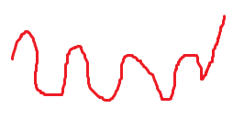

Random Initialization
For gradient descent and advanced optimization method, we need to set initial $θ$
Where???

Slide 11
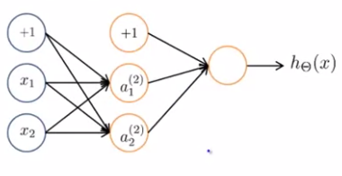


Random Initialization
Zero initialization
$a_{1}^{(2)}=a_{2}^{(2)}⇒ δ_{1}^{(2)}=δ_{2}^{(2)}$
$D_{1}^{(2)}=D_{1}^{(2)}⇒θ_{1}^{(2)}=θ_{2}^{(2)}$
All hidden units compute the exact same function

Slide 12


Random initialization
Symmetry breaking
Normally, $ε=1$

Slide 13
Putting it together

Slide 14
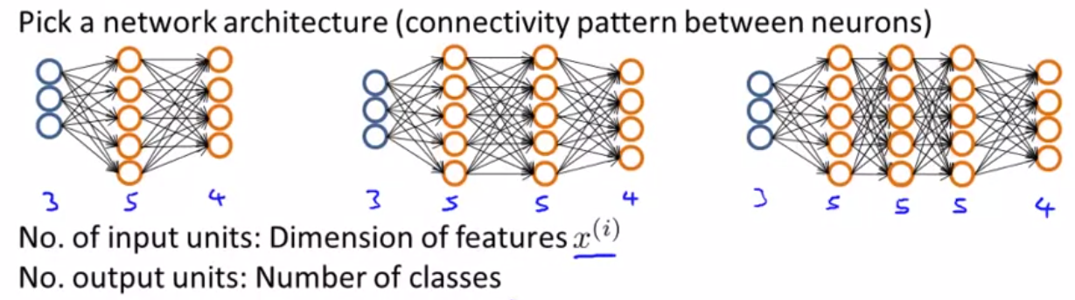
Training a neutral network

Slide 15
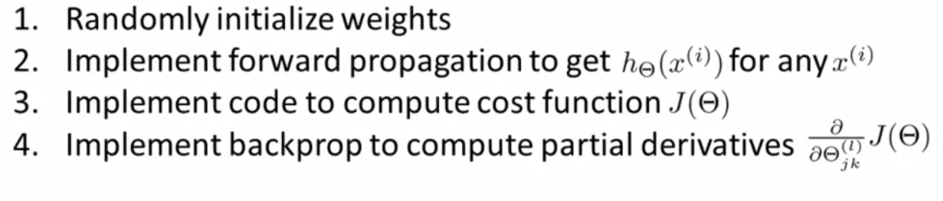

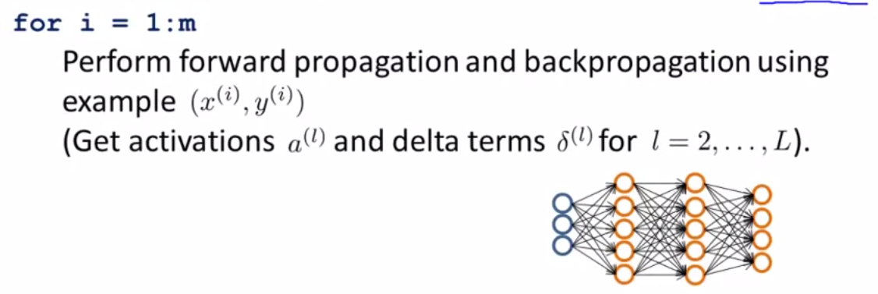
Training a neutral network

Slide 16
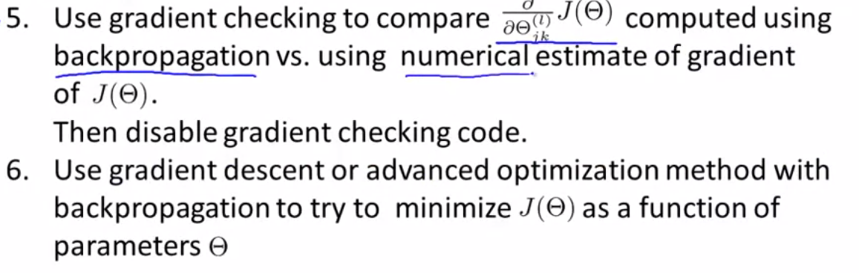
Training a neutral network

Slide 17
